Slide 1
Enhancing Link Prediction in Real-World Networks Using Graph Coloring Techniques
Done by : Amani Krieshan and leen masaadeh
DR. Dana ElRushaidat

Slide 2
Introduction
In real-world complex networks, like social networks,
recommendation systems, and biological systems,
link predictions a crucial task. The complexities of dynamic,
largescale, and heterogeneous networks are frequently too much for traditional link prediction techniques like matrix factorisationor similarity-based approaches to handle. The dynamic inter-actions and intricate topologies present in these networks areusually not captured by current techniques

Slide 3
Dataset
For this project, we will use the ”Musae GitHub SocialNetwork dataset available on Kaggle. This dataset represents a large social network of GitHub developers, collected in June 2019 via the public GitHub API.
1. Edge List :Represents the follower relationships between GitHub developers
2 Node Features :Includes information like location, repositories starred, employer, and email address of the developers.
IV-B1.3 Target Variable :A binary classification indicating whether the developer is primarily a web developer or a machine learning developer, derived from their job title.

Slide 4
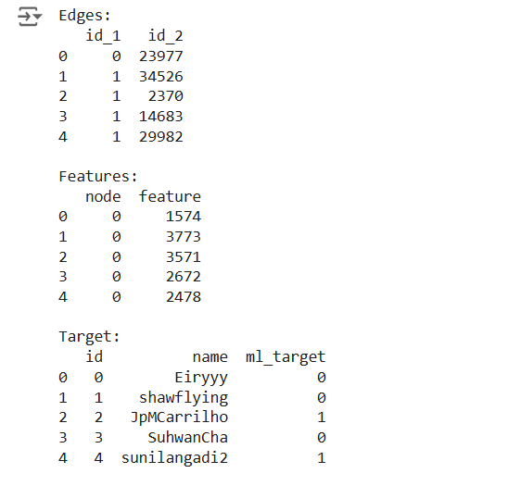

Slide 5
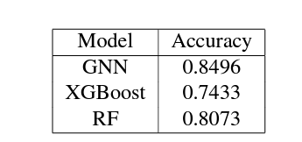
Models
GNN model
Random Forest
Extreme Gradient Boosting(XGBoost)

Slide 6
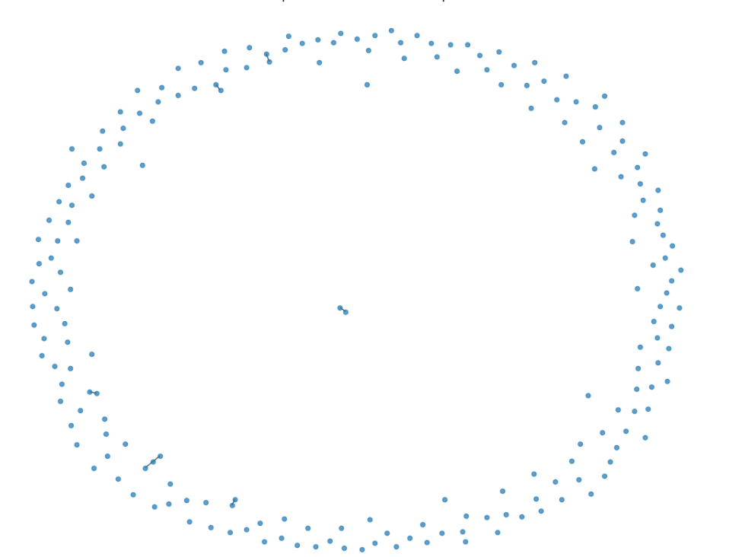
Before applying graph coloring

Slide 7
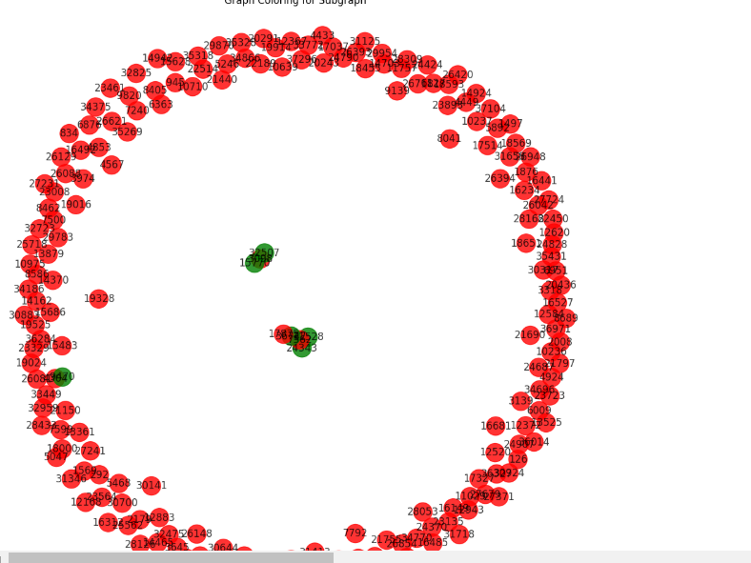
After applying graph coloring

Slide 8
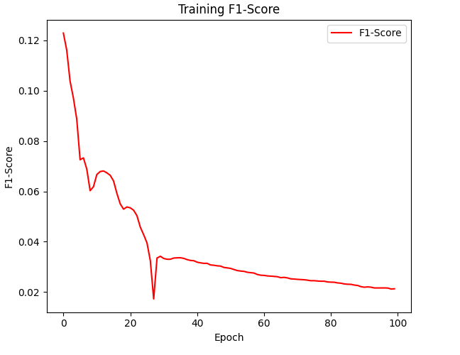
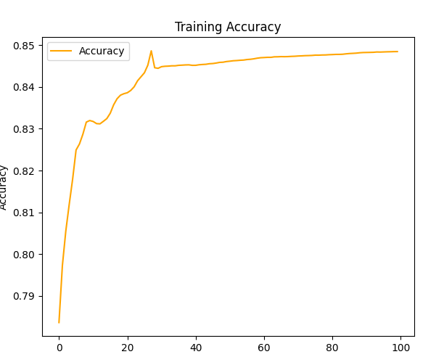
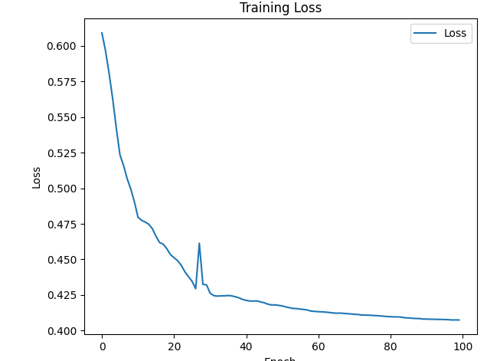
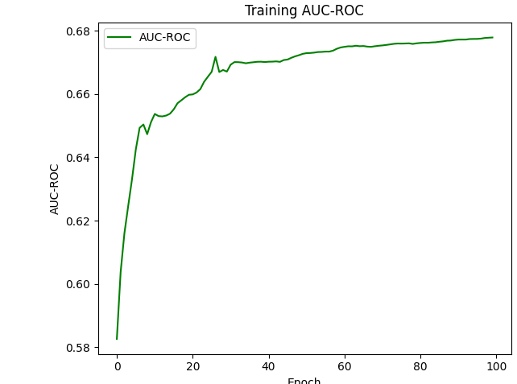
GNN Model results

Slide 9
Conclusion
This study demonstrated the effectiveness of the GNN model in link prediction within GitHub’s collaborative graph, achieving excellent accuracy and outperforming traditional machine learning approaches. However, the process was not without challenges. The dataset, while large, presented issues with quality and consistency, which impacted preprocessing and training. Additionally, the sheer size of the data posed computational challenges, requiring careful optimization of the model and resources. Despite these obstacles, the GNN model proved its capability in handling complex graph structures, highlighting its potential for practical applications in recommendation systems and network analysis. Future work could focus on addressing data quality issues and exploring more efficient techniques to manage large-scale graphs.

